Slide 1
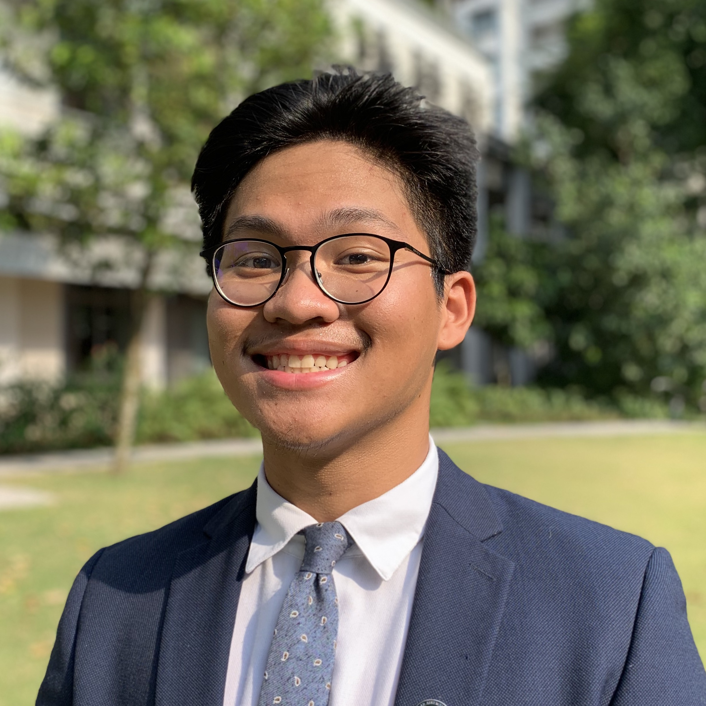
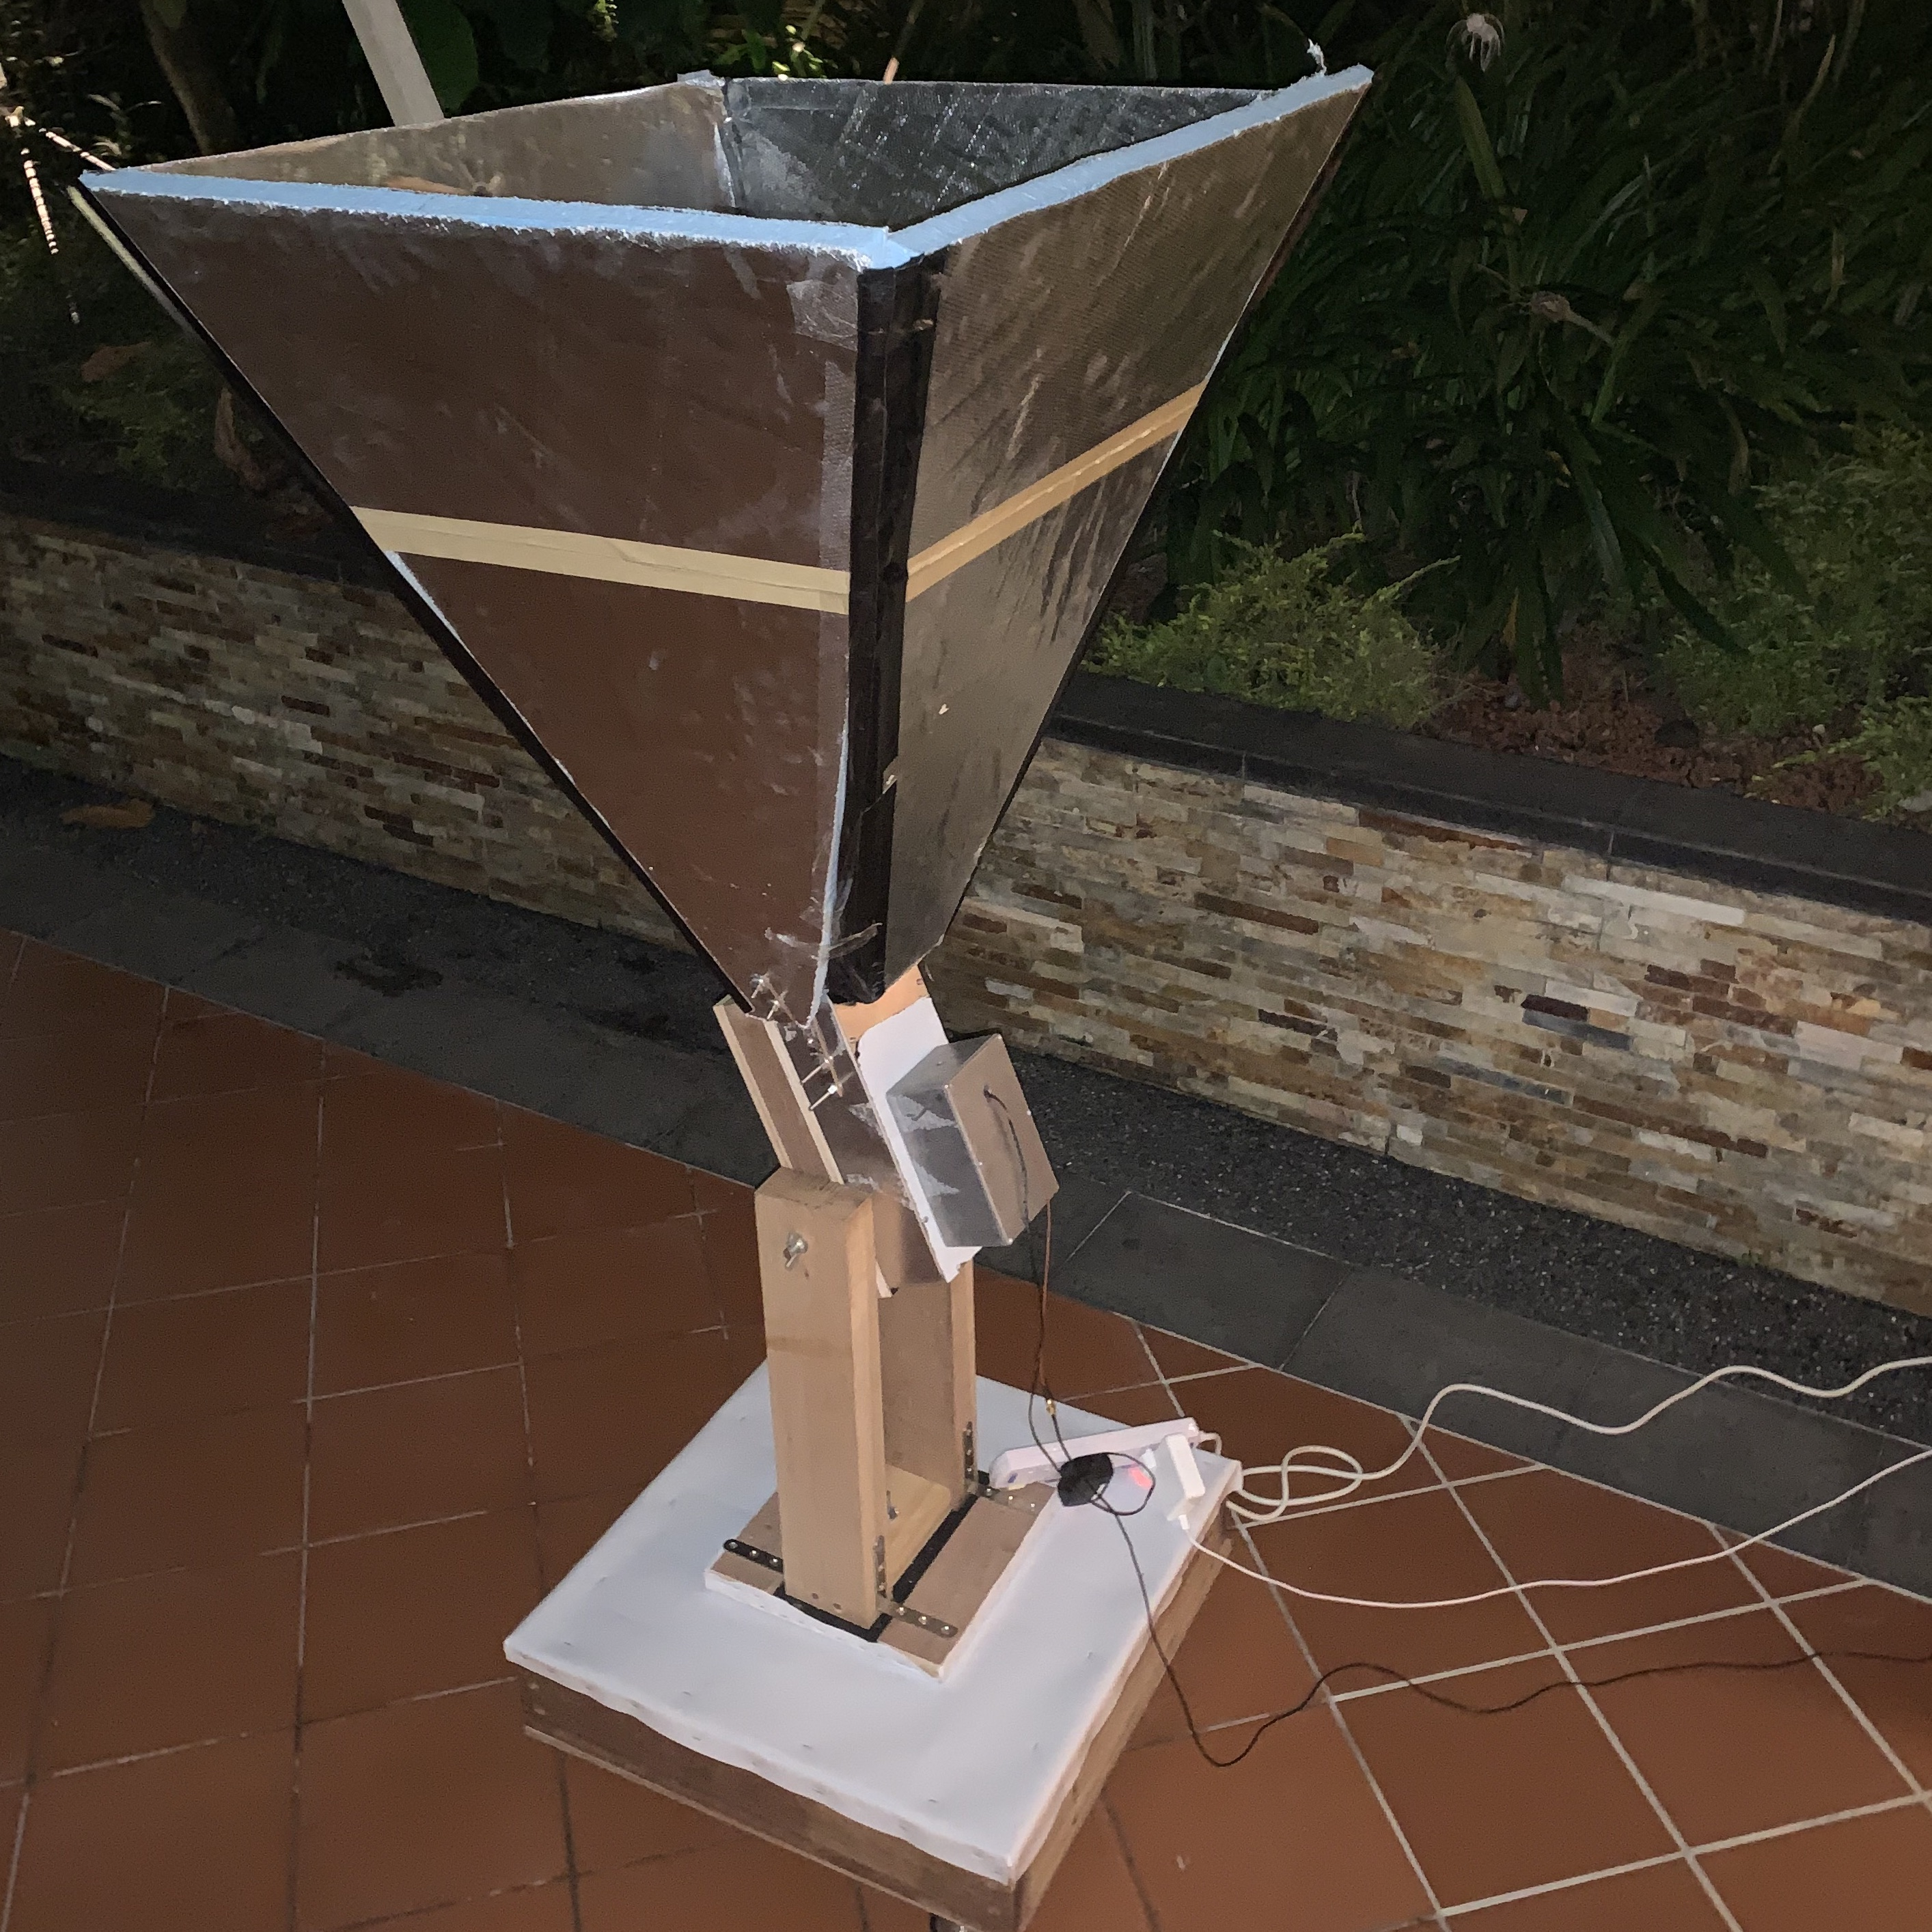
SRP: Build a Prototype Radio Telescope
A presentation by m. Zirdi Syukur
Supervisor: Professor Chelsea Sharon

Slide 2
About Me
How I got involved
About Me
M. Zirdi Syukur
Second Year
Prospective Physical Science Major (Physics)
No prior research experience
Symposium!

Slide 3
Brief Overview
Why build the telescope?
What approach did I take to building the telescope?
What can the telescope do and what are its limitations?

Slide 4
Why Build a telescope?
Singapore is notorious for terrible skies for astronomy.
Anecdotally, radio astronomy is not possible.

Slide 5
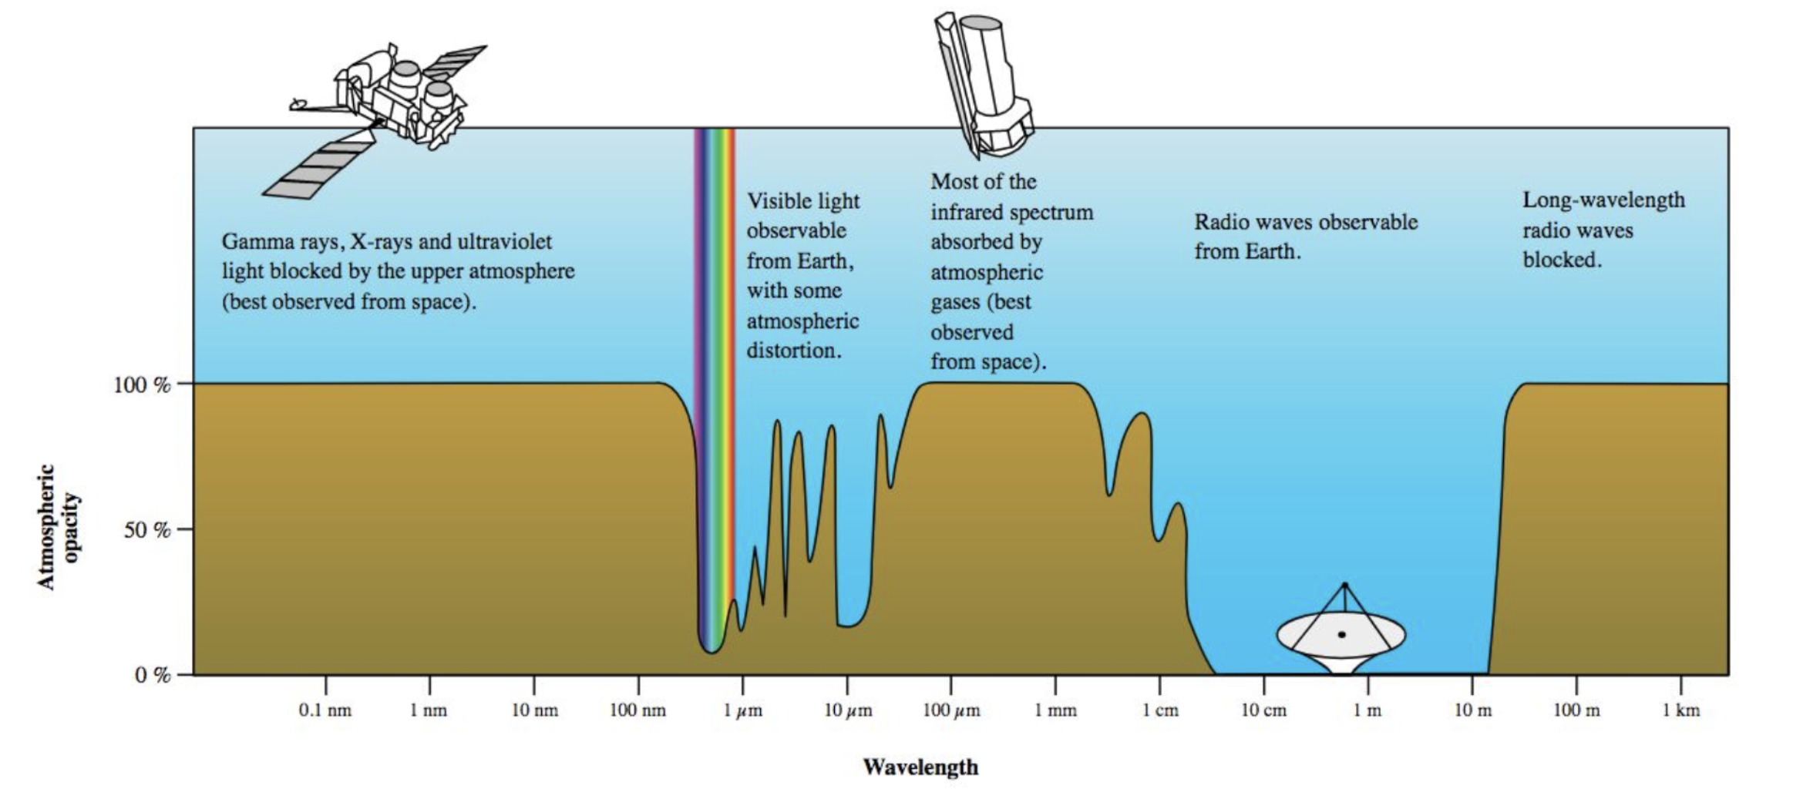
Why Radio Astronomy?

Slide 6
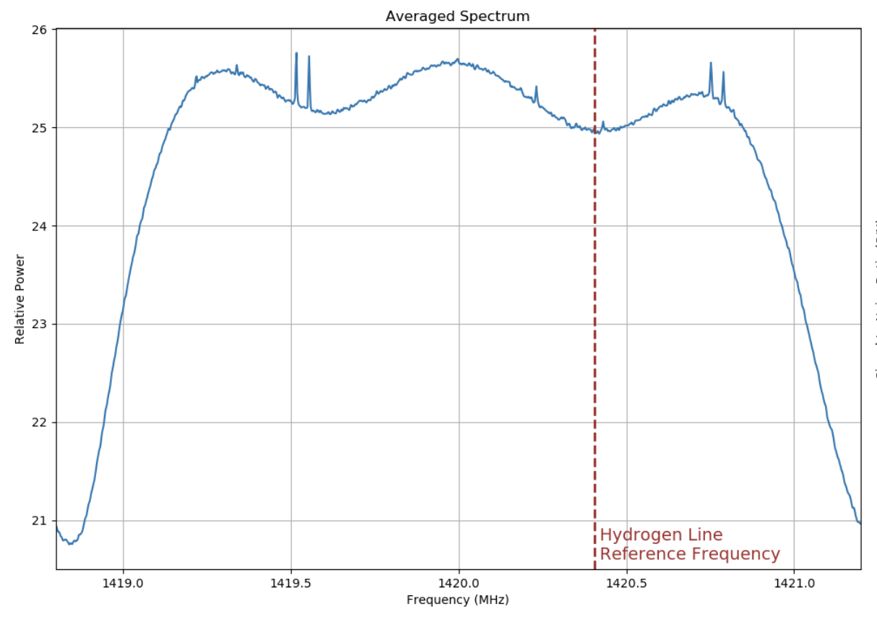
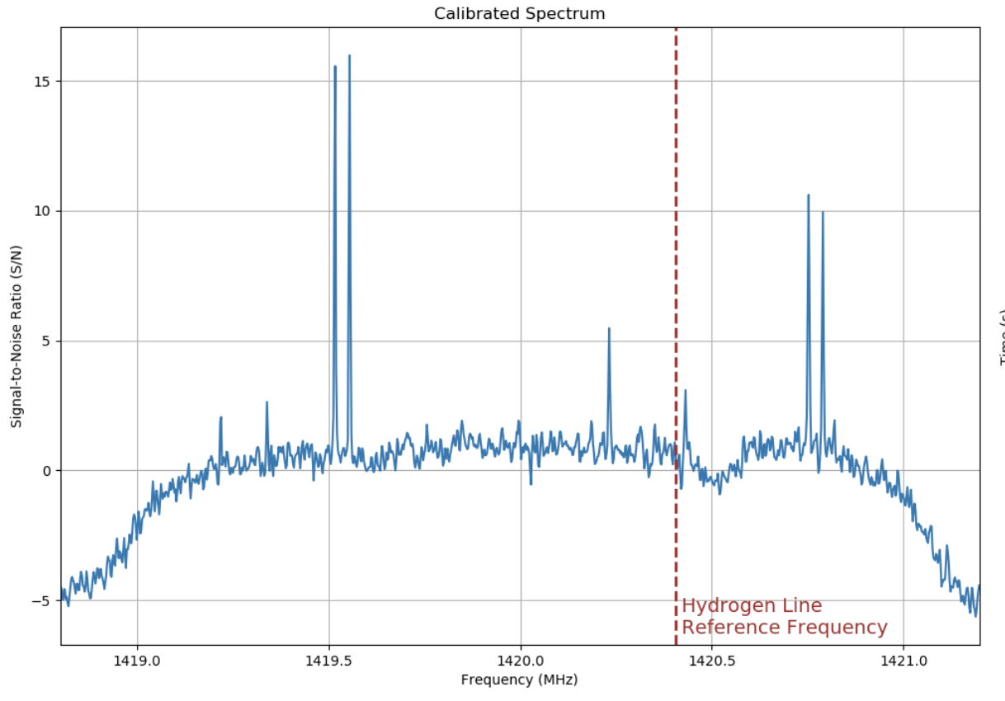
WHY Build: Noise of Singapore
Sources of noise for radio astronomy – urban electronics
Internationally protected frequencies for astronomy
Test feasibility of radio astronomy by characterizing noise levels of Singapore

Slide 7
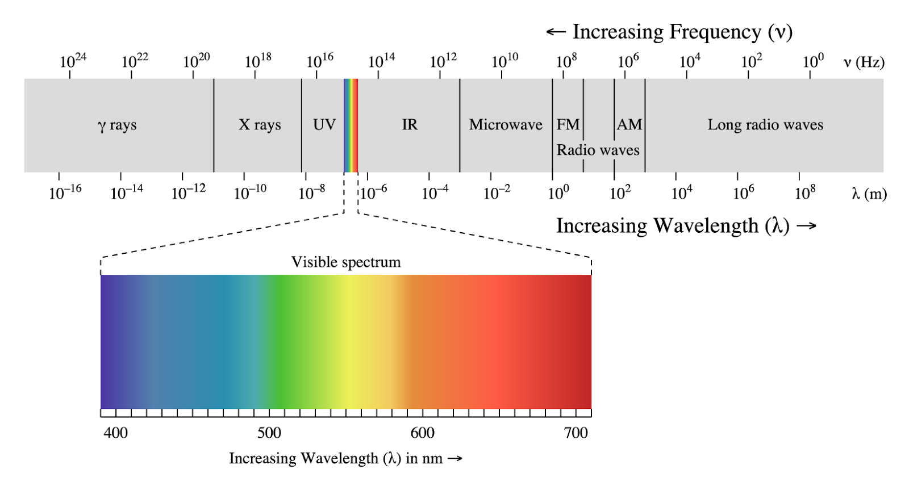
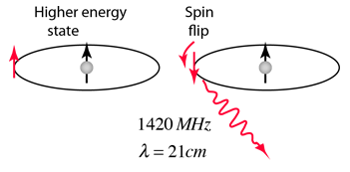
WHY BUILD:
To test feasibility -> detect hydrogen line
precursor to spectral-line astronomy
excitations of neutral hydrogen and subsequent release of energy (21 cm or 1.42 Ghz)
abundant
penetrates gas clouds

Slide 8
What Approach: 3 step process
Frontend
Backend
Data collection

Slide 9
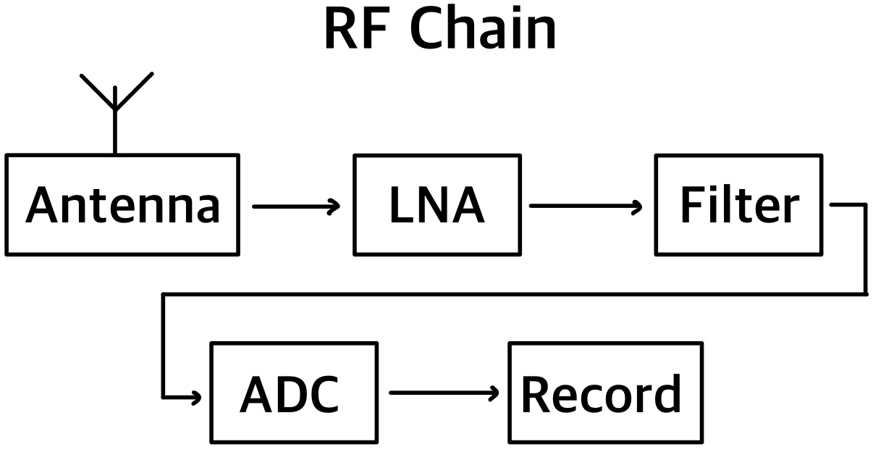
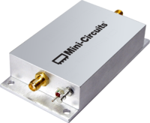
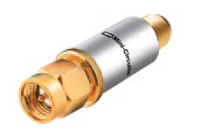
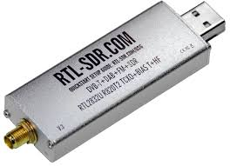
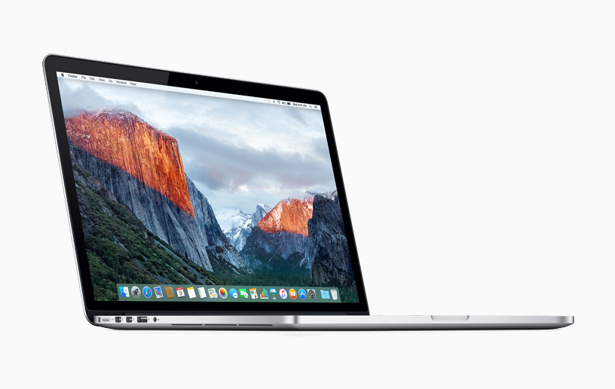
Step 1: Building (Frontends)
Most of the framework already done
Designs from DSPIRA project
Troubleshooting
Replaced ADC for compatibility issues
Tightened bolts and secured loose parts

Slide 10
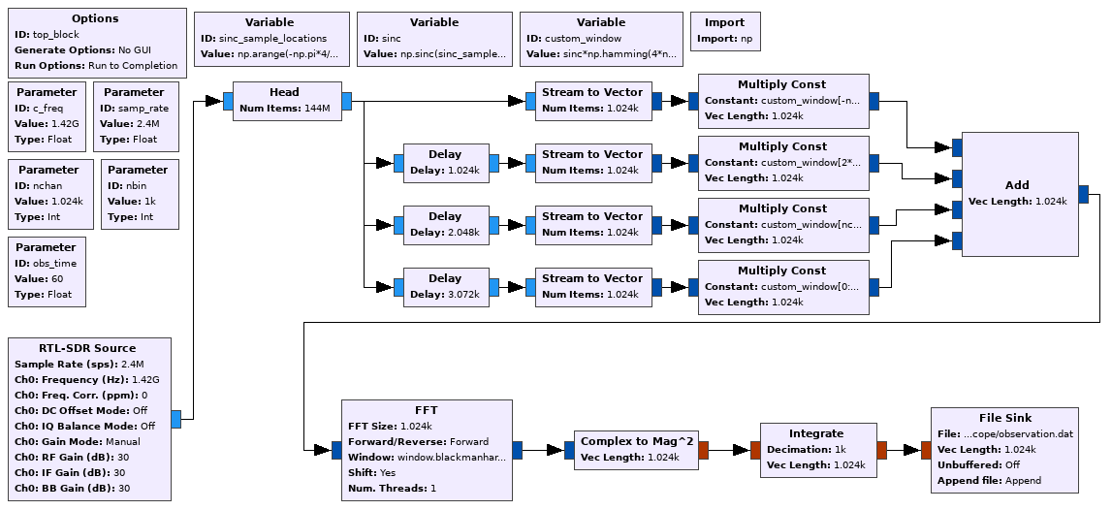
Step 2: Software (Backends) (VIRGO)
Source
Polyphase filter-bank
Fast Fourier Transform
float-32 power vs frequency data
Graphing the data
VIRGO vs gr-radio-astro

Slide 11
FFT

Slide 12
Polyphase filterbank

Slide 13
Plotting and Calibrating

Slide 14
Off Measurements

Slide 15
On measurements

Slide 16
On measurements

Slide 17
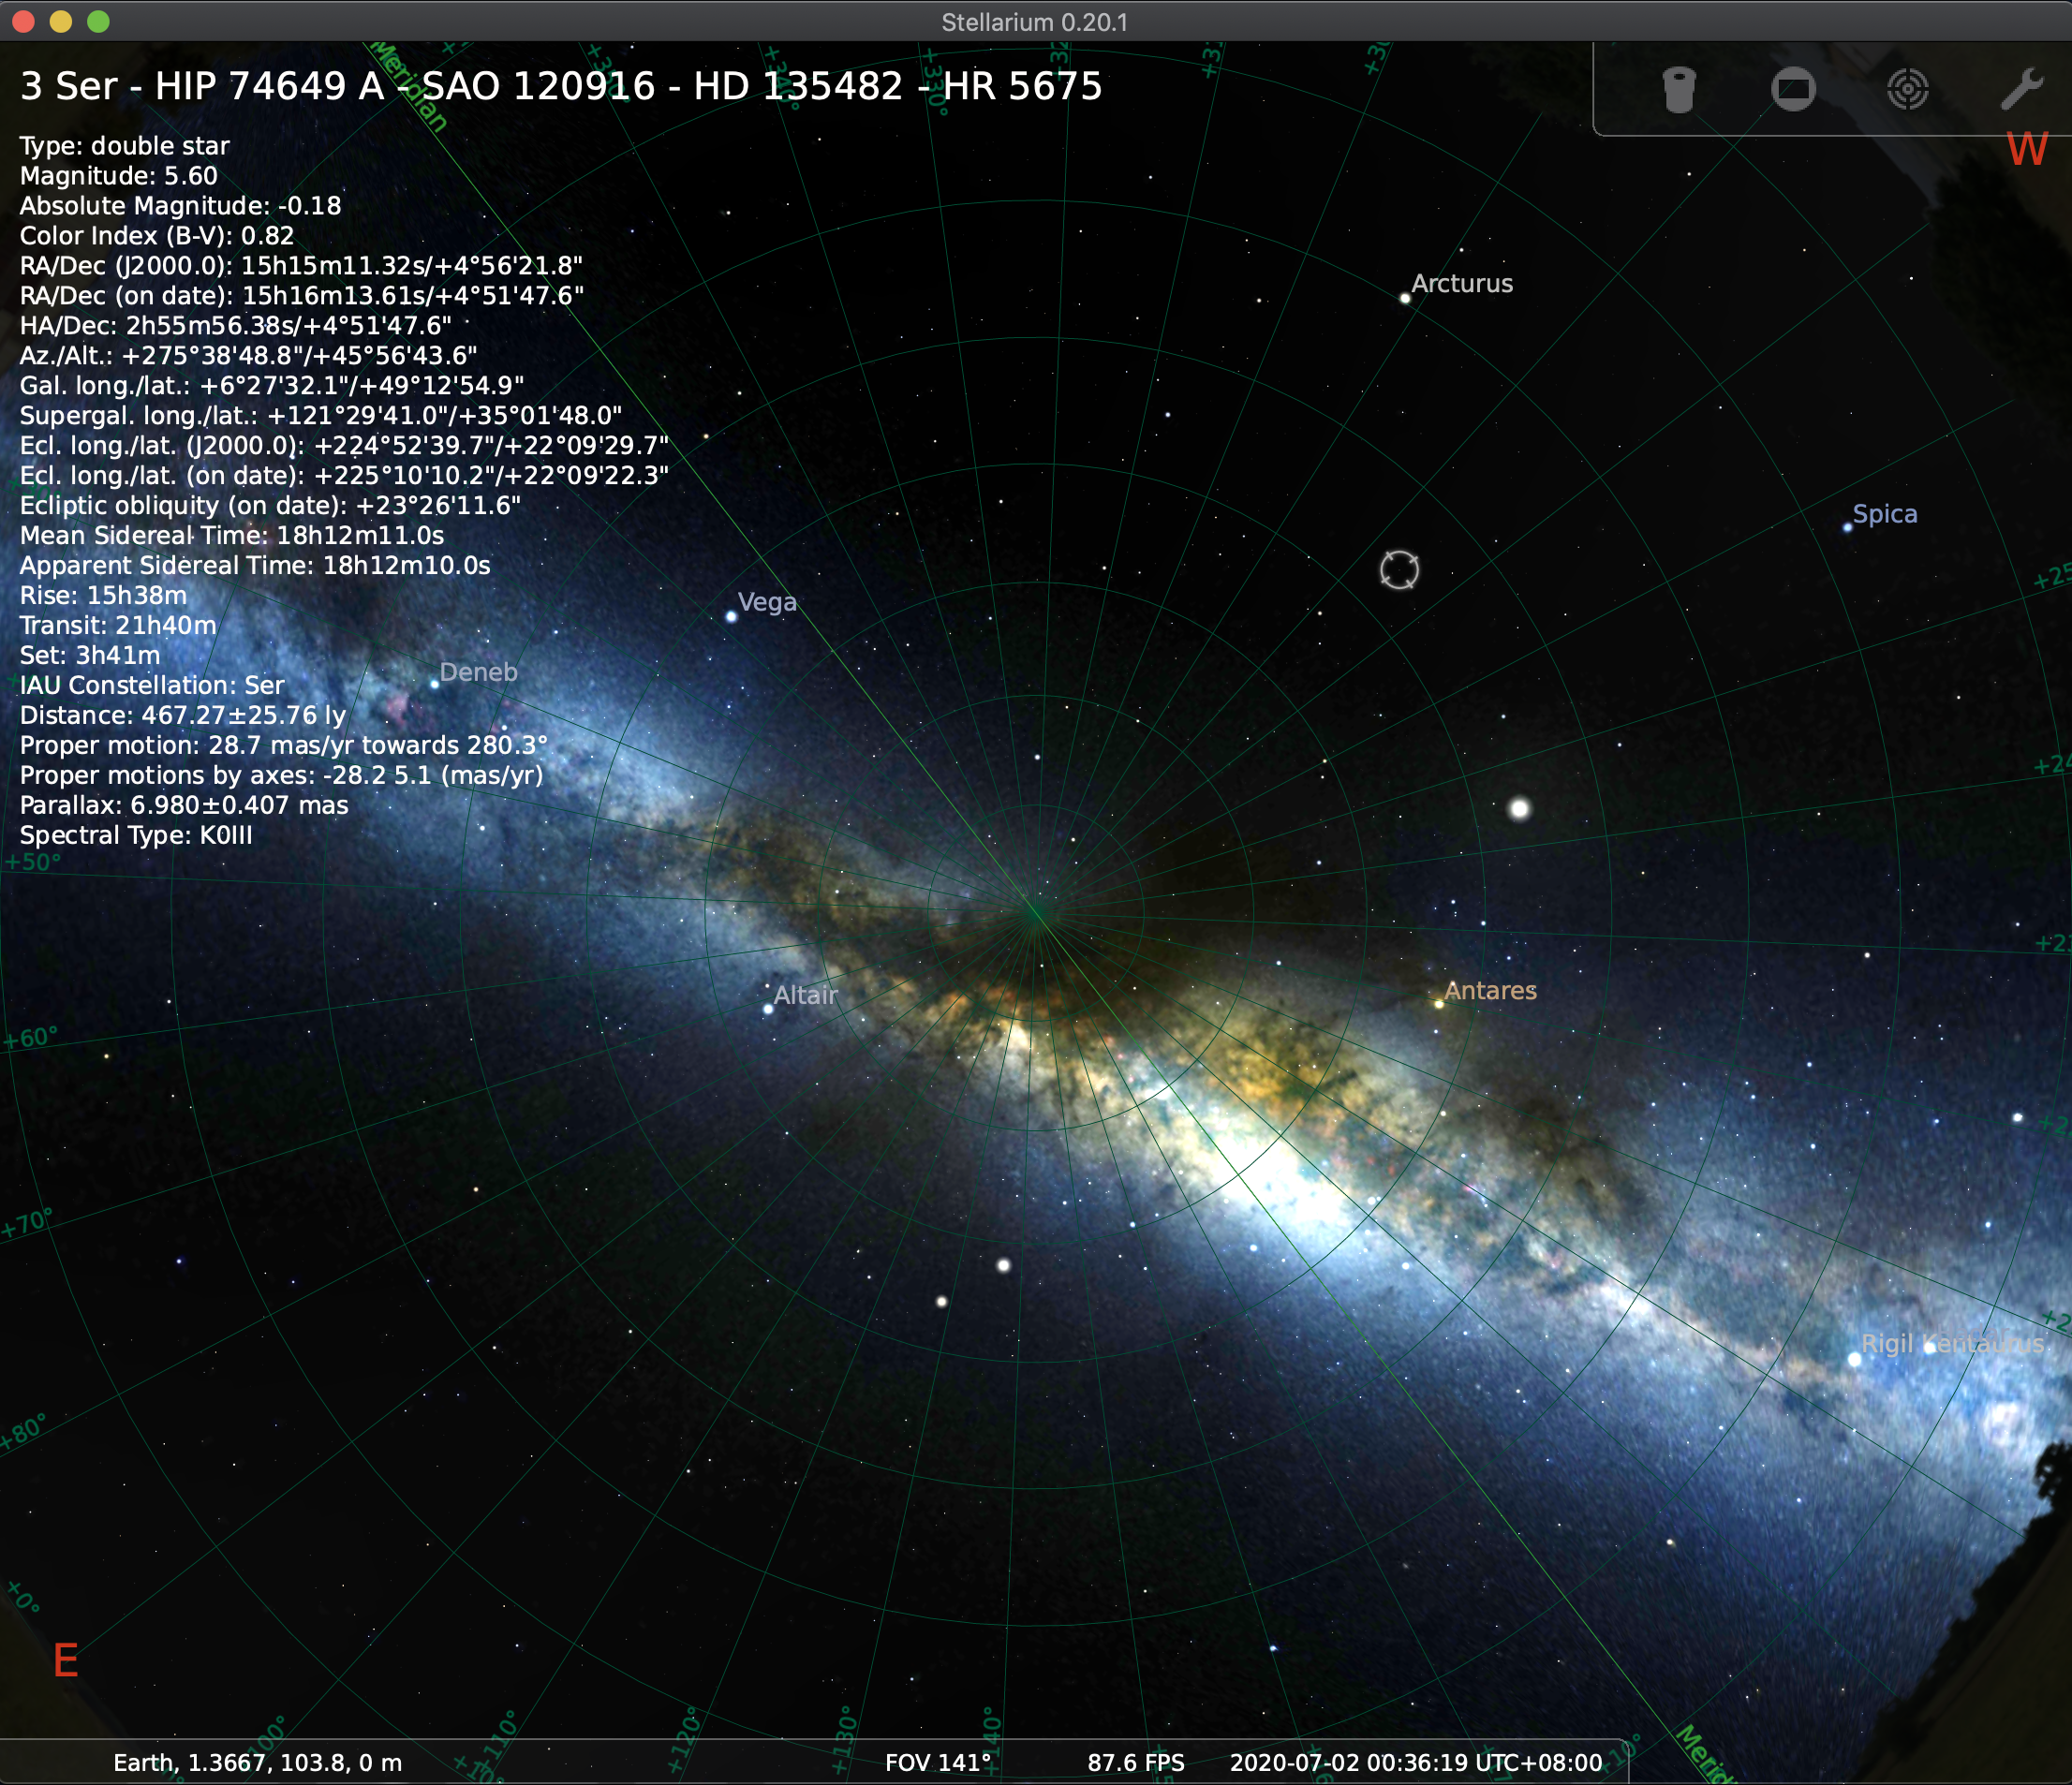
Step 3: Collecting Data
Testing different variables
Day
Night
Location and direction
Different off measurements
Stellarium

Slide 18
What are the results?

Slide 19
What are its limitations

Slide 20
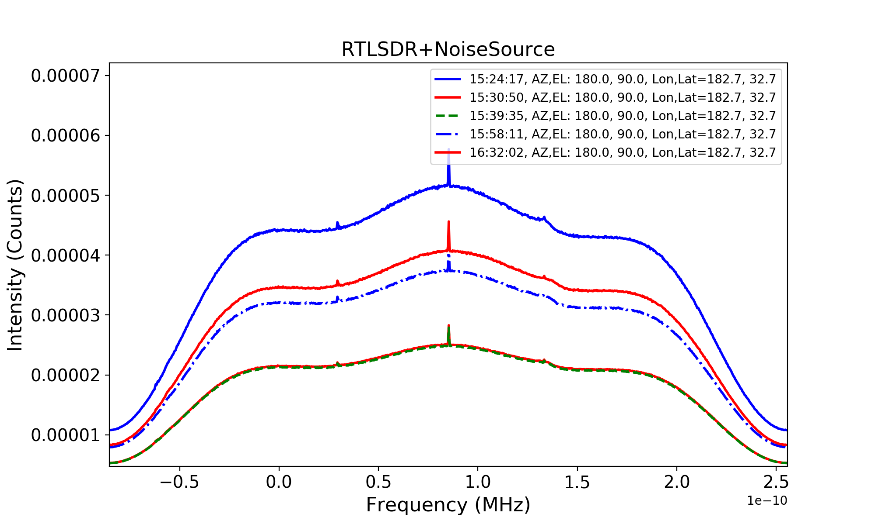
Next steps
Improvements to the project:
Clearer Peaks (with sidelobes)
Flattened edges
More RFI Shielding
More Robust Off Measurement Calibrations
Other projects and next steps
More robust knowledge of gr-radio-astro
Galactic map and spiral arms of milky way? Detecting Andromeda? Pedagology?
Proposal of a larger telescope?

Slide 21
Acknowledgements
Supervisor Professor Chelsea Sharon
Assistance of Professor Ben Olsen
Dean of Faculty office
CIPE

Slide 22
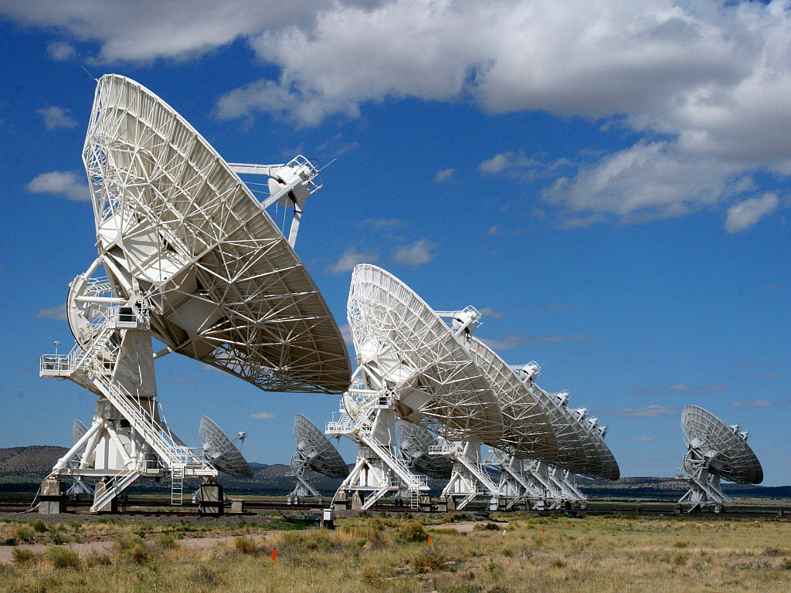
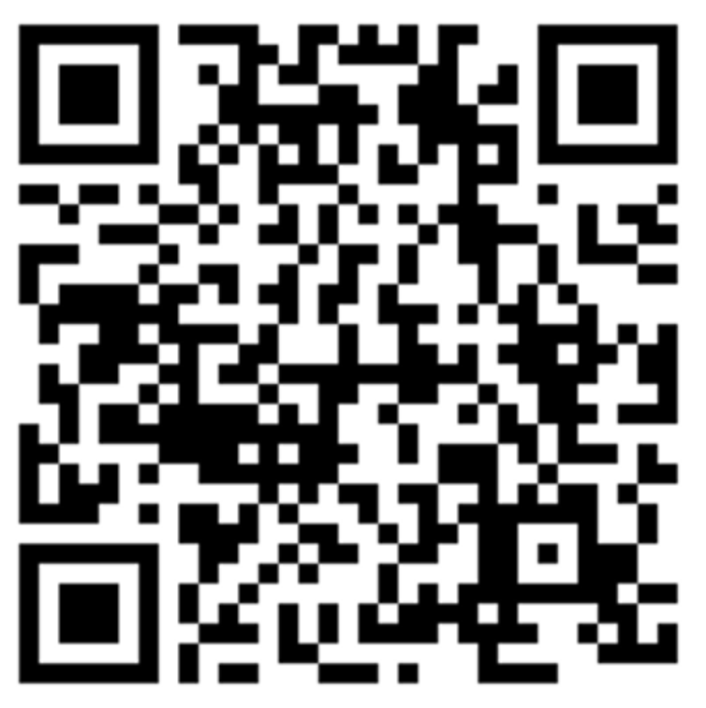
Thank You Feedback is welcome zirdisyukur@u.yale-nus.edu.sg

